Slide 1
Crash course into supervised machine learning
/oana

Slide 2
Recap: Descriptive Analytics
Looks at data to examine, understand, and describe something that has already happened.
Looks at events in the past → Identify specific patterns
Commonly used visuals: pie charts, bar charts, tables, line graphs
Example:
How many sales occurred in the last quarter?

Slide 3
Recap: Predictive Analytics
Relies on historical data, past trends, and assumptions to answer questions about what is likely to happen in the future.
Techniques:
Regression analysis, forecasting, multivariate statistics, predictive modeling
Requirements for these techniques are large amounts of high-quality and historic data. They are also done using programming such as R and Python.
Example:
How will the next marketing campaign impact the customer engagement?

Slide 4
Recap: Prescriptive Analytics
Identifies specific actions an individual or organization should take to reach future targets or goals.
Techniques:
Graph analysis, simulation, neural networks, machine learning
This is one of the most advanced level of analytics and it heavily depends on the accuracy of the descriptive, diagnostic, and predictive analysis. It also heavily relies on quality of data and the appropriate data architecture and expertise.
Organization will be able to make decisions based on highly analyzed facts rather than instinct.

Slide 5
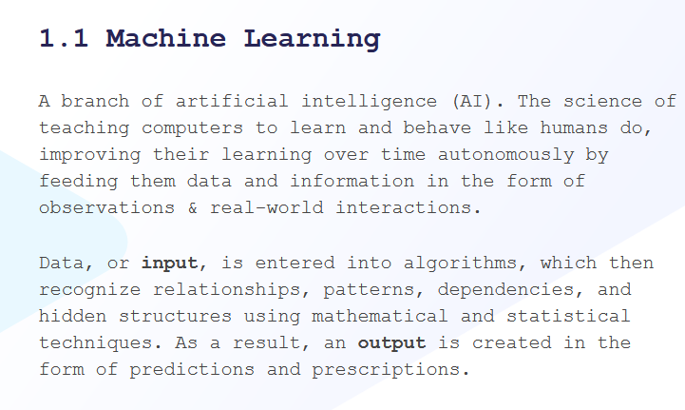
Machine learning /vs AI
Notes:
https://eproduct.hbsp.harvard.edu/eproduct/product/t_ie_machine_learning_en/content/en/intro/index.html

Slide 6
Machine Learning is...
... learning from data ... no explicit programming ... discovering hidden patterns ... essential for data-driven decisions
e.g.
Credit card fraud detection
Handwritten digit recognition
Recommendations on websites

Slide 7
Types of machine learning

Slide 8
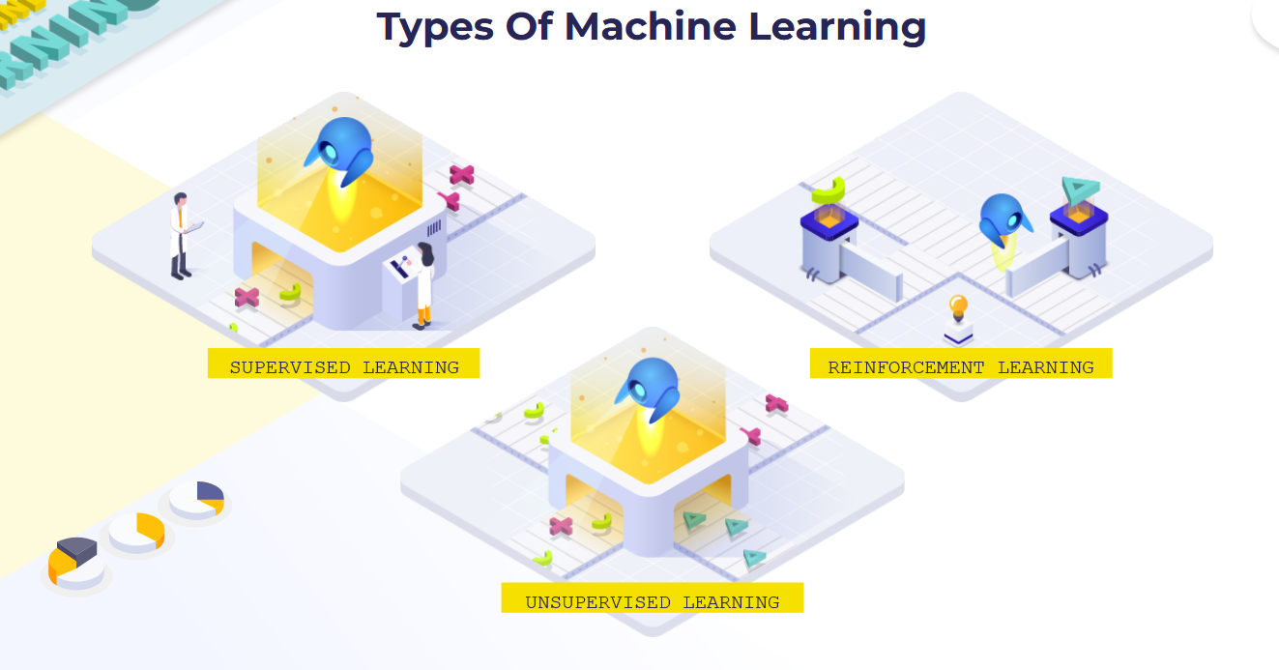
Types of ml
Notes:
https://eproduct.hbsp.harvard.edu/eproduct/product/t_ie_machine_learning_en/content/en/intro/index.html

Slide 9
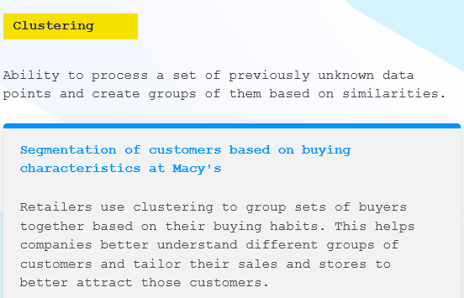
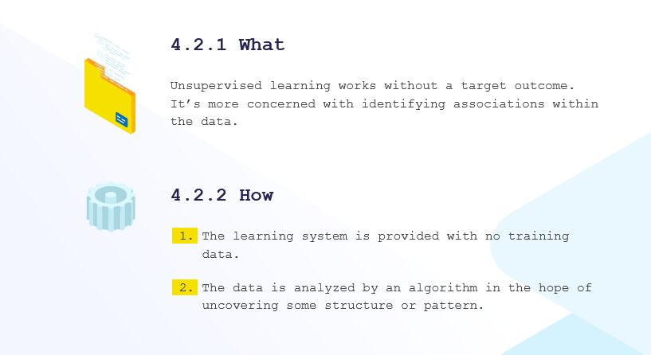
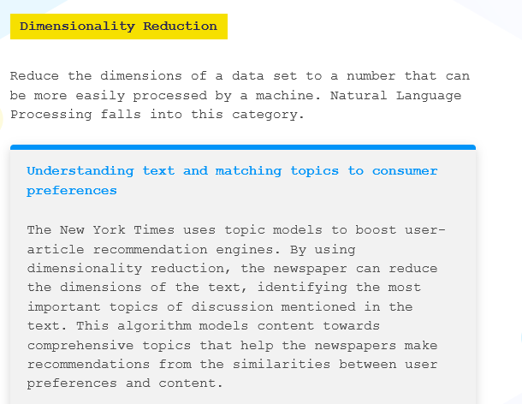
Unsupervised ML

Slide 10
Supervised Machine Learning

Slide 11
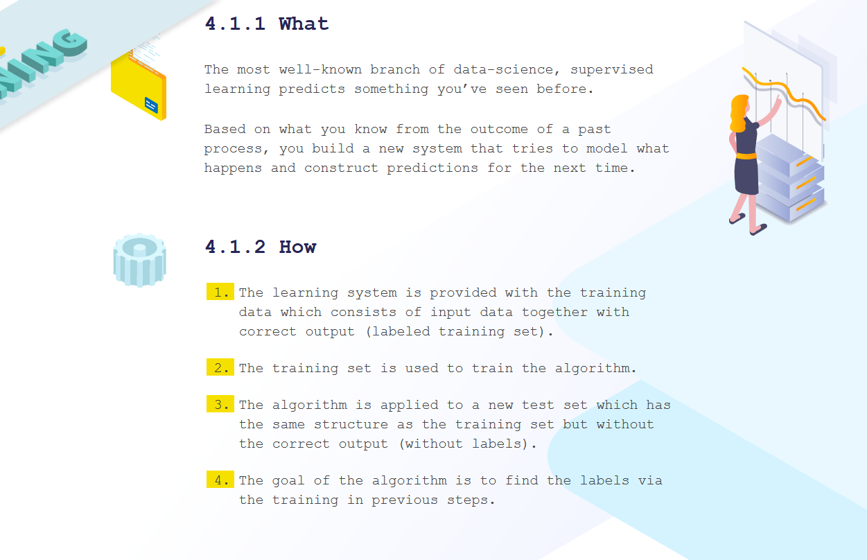
Supervised ML

Slide 12
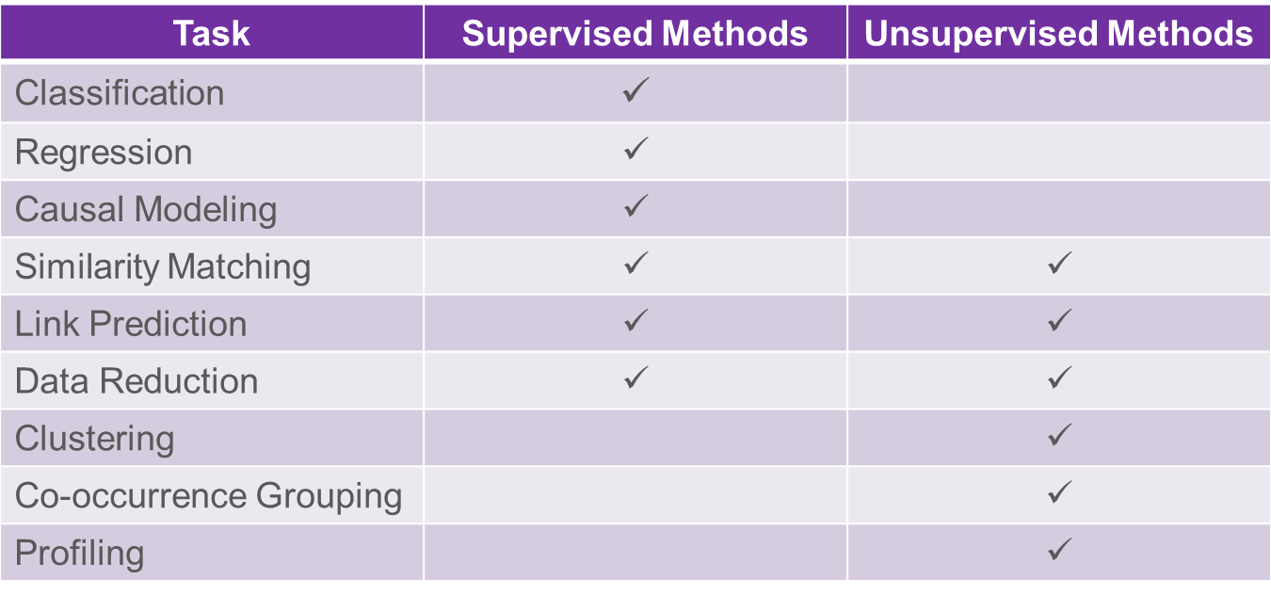
Common Data analytics Tasks

Slide 13
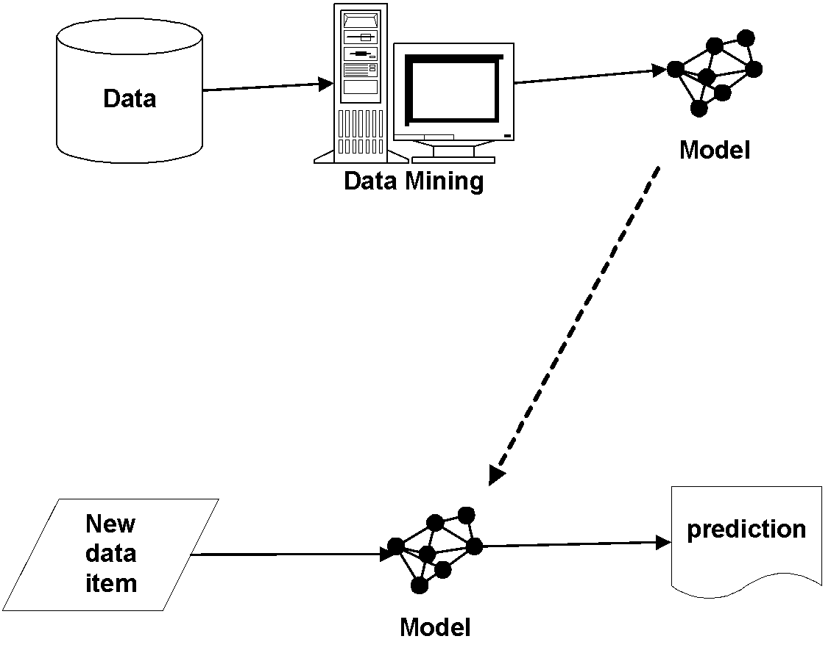
Data Mining versus Use of the Model
“Supervised” modeling:
“Training” data have all
values specified
Model in use:
New data item has some value unknown (e.g., will she leave?)

Slide 14
Supervised versus Unsupervised Methods
“Do our customers naturally fall into different groups?”
No guarantee that the results are meaningful or will be useful for any particular purpose
“Can we find groups of customers who have particularly high likelihoods of canceling their service soon after contracts expire?”
A specific purpose
Much more useful results (usually)
Different techniques
Requires data on the target
The individual’s label

Slide 15
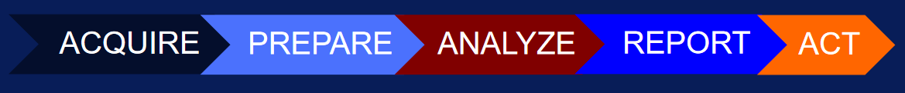
Machine learning pipeline/recipe (works also for unsupervised)
Notes:
There are others but as you can see it is quite generic
https://towardsdatascience.com/architecting-a-machine-learning-pipeline-a847f094d1c7

Slide 16
Machine learning pipeline (recipe)

Slide 17
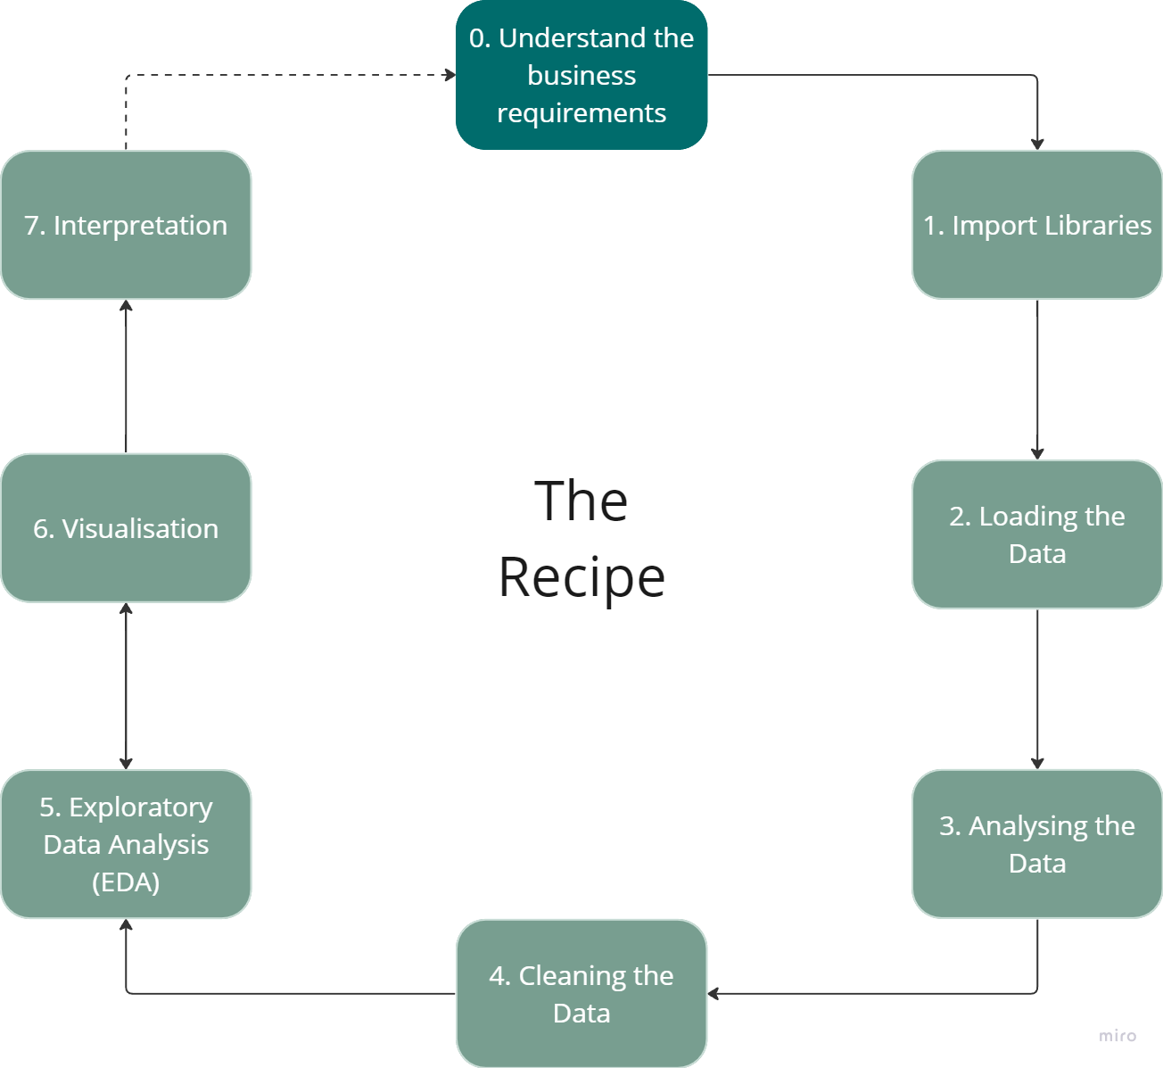
The recipe for data analysis

Slide 18
Step 6(2): Analyze Data
Select analytical techniques
Supervised, unsupervised
Supervised: Based on your target variable: classifiers or regressions
Split the data
Unsupervised: cluster analysis, association analysis
Doesn’t require data split
Build models using train data
Assess results using test data

Slide 19
What is a model?
A simplified* representation of reality created for a specific purpose
*based on some assumptions
Examples: map, prototype, Black-Scholes model, etc.
Data analytics example:
“formula” for predicting probability of customer attrition at contract expiration
🡪 “classification model” or “class-probability estimation model”

Slide 20
Classification
Goal: given input, predict category
Classify tumor as benign or malignant Predict if it will rain tomorrow Determine if loan application is high-,medium-, or low-risk Identify sentiment as positive, negative, or neutral
Examples: LDA, SVM, decision tree, KNN, naïve bayes

Slide 21
Regression
Goal: Given input variables, predict numeric value
Forecast high temperature for next day Estimate average house price for a region Determine demand for a new product Predict power usage
Examples: linear regression, non linear regression, decision tree

Slide 22
Build models
1. models – where do they come from
2. how to choose
loss functions
Explainability: do you need to explain to stakeholders?
Accuracy

Slide 23
Models, where do they come from

Slide 24
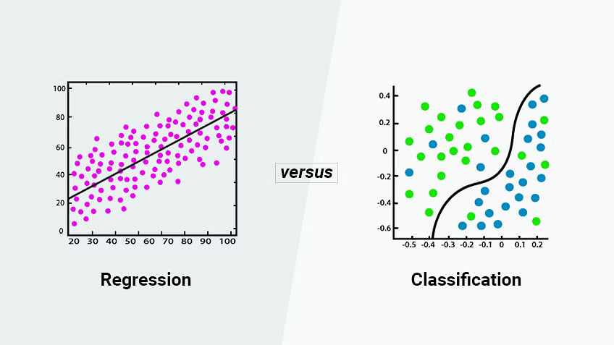
Regression vs classification

Slide 25
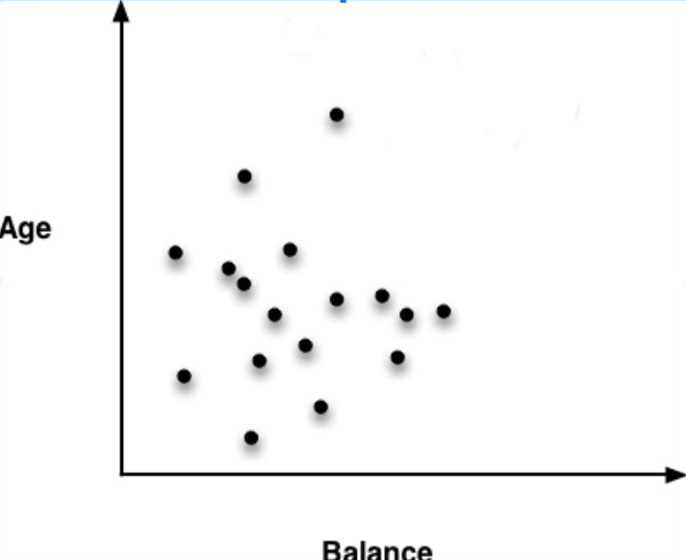
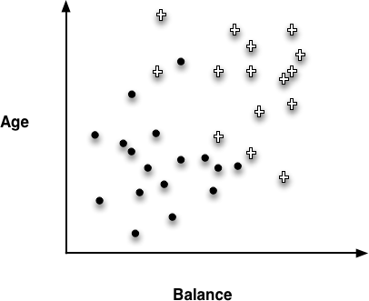
Instance Space regression vs linear classifier

Slide 26
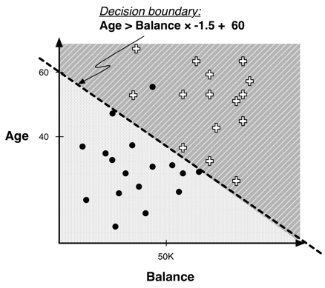
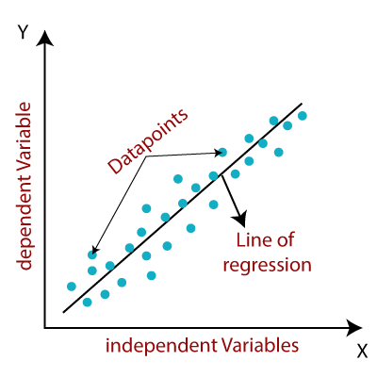
Regression vs linear classfier

Slide 27
Example of regression Function
Linear regression:
Y = 1.0 × 𝐴𝑔𝑒 − 1.5 × 𝐵𝑎𝑙𝑎𝑛𝑐𝑒 + 60
• We now have a parameterized model: the weights of the linear function are the parameters
• The weights are often loosely interpreted as importance indicators of the features

Slide 28
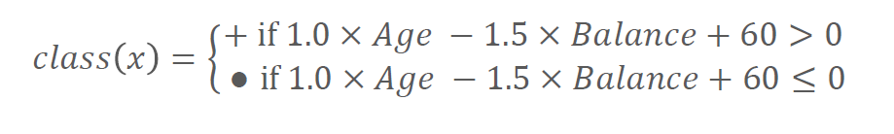
Example of Classification Function
Linear discriminant:
We now have a parameterized model: the weights of the linear
function are the parameters
• The weights are often loosely interpreted as importance indicators
of the features
• A different sort of multivariate supervised segmentation
• The difference from DTs is that the method for taking multiple attributes
into account is to create a mathematical function of them

Slide 29
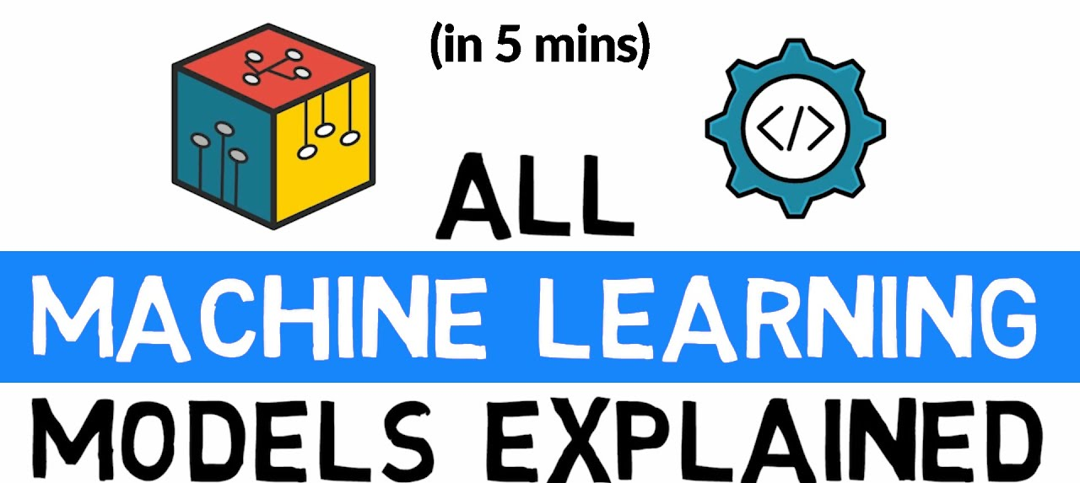
Other models
There are MANY MANY more, e.g. random forests, decision trees, neural networks etc.

Slide 30
Models, how to choose

Slide 31
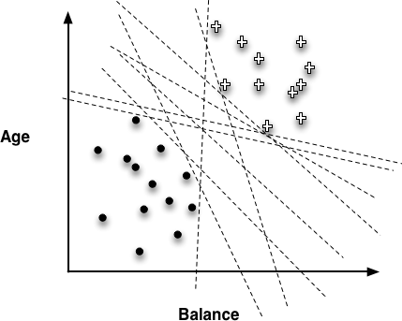
Choosing the “best” line

Slide 32
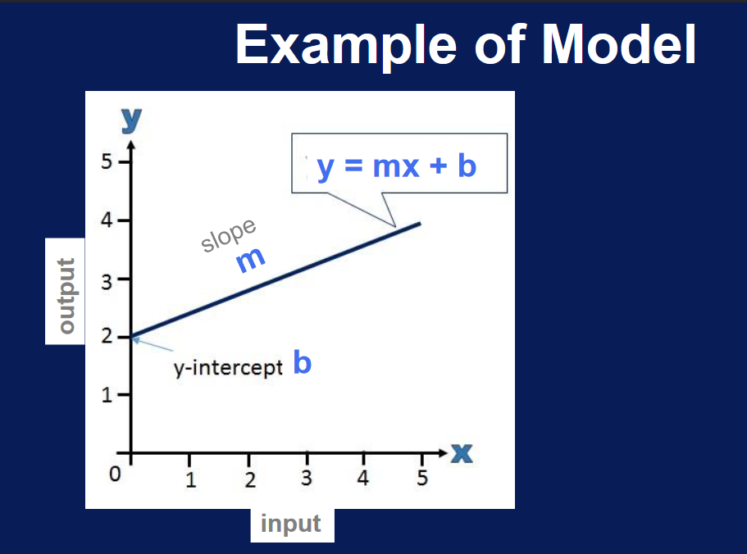

Slide 33
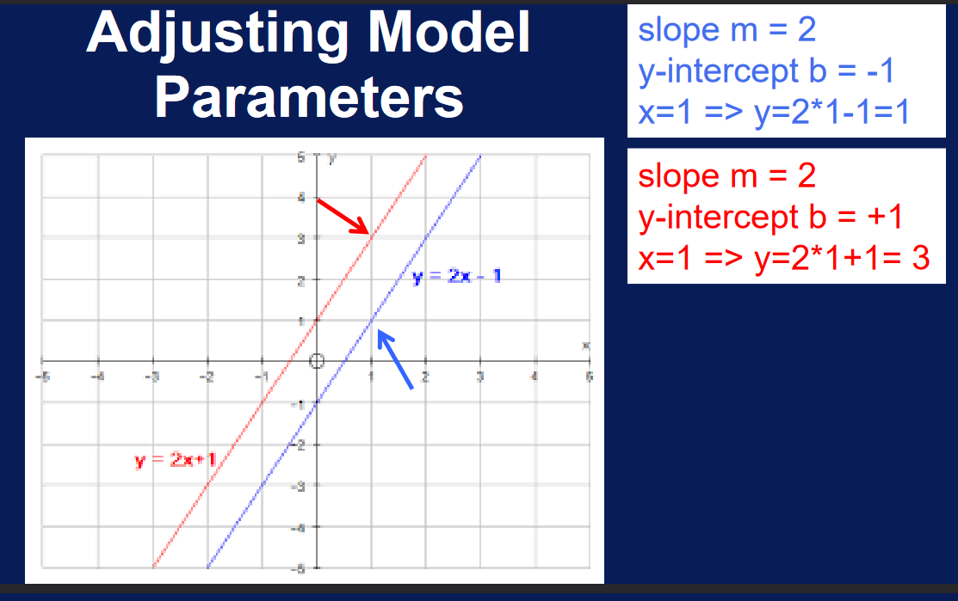

Slide 34
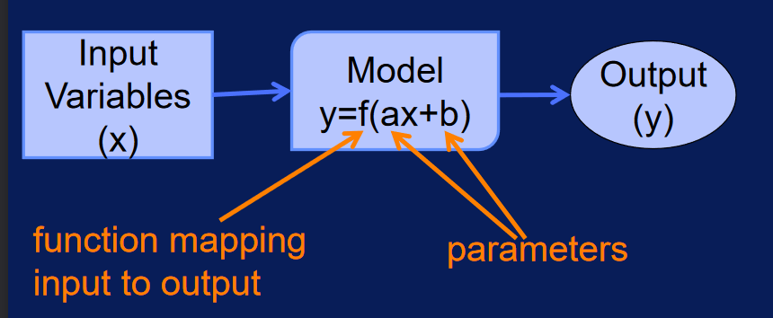
Building Machine Learning Model
Model parameters are adjusted during model training to change input-output mapping via loss functions

Slide 35
Data Mining versus Use of the Model
“Supervised” modeling:
“Training” data have all
values specified
Model in use:
New data item has some value unknown (e.g., will she leave?)

Slide 36
Phew. We made it!

Slide 37
Data storage solutions

Slide 38

Data storage solutions
Data storage solutions are essential for managing and organizing large amounts of data.
There are several types of data storage solutions, including SQL databases, data silos, data warehouses, cloud storage, and file storage.
Choosing the right data storage solution depends on factors such as the size and complexity of the data, the need for scalability, and the level of accessibility required.

Slide 39
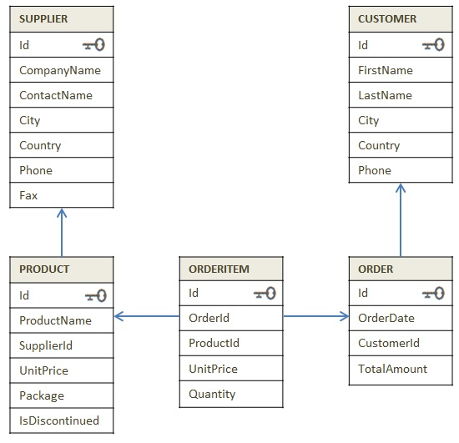
SQL Databases
SQL (Structured Query Language) is a programming language used to manage and manipulate relational databases.
SQL databases store data in tables with rows and columns, allowing for easy querying and retrieval of data.
SQL databases are widely used in a variety of applications, including business operations, customer relationship management, and e-commerce.

Slide 40
Data Silos vs. Data Warehouses + File vs. cloud storage
A data silo is a repository of fixed data that remains under the control of one department and is isolated from the rest of the organization.
A data warehouse is a large, centralized repository of data that is used to support business intelligence and decision-making activities.
Unlike data silos, data warehouses integrate data from multiple sources and make it accessible to users across the organization.
Data warehouses also support advanced analytics and reporting capabilities.
Cloud storage involves storing data on remote servers that can be accessed over the internet.
File storage involves storing data on local servers or devices.
Cloud storage offers several advantages over file storage, including scalability, accessibility, and cost-effectiveness.
Cloud storage also provides greater flexibility and can be easily integrated with other cloud-based services.

Slide 41
Phew. We made it x 2 :P!

Slide 42

Evaluating classifiers

Slide 43
Linear Classifier

Slide 44
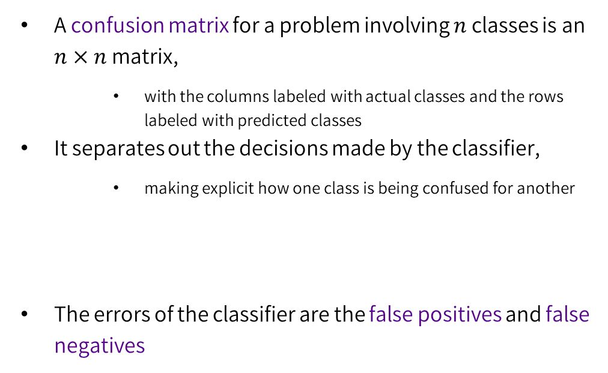
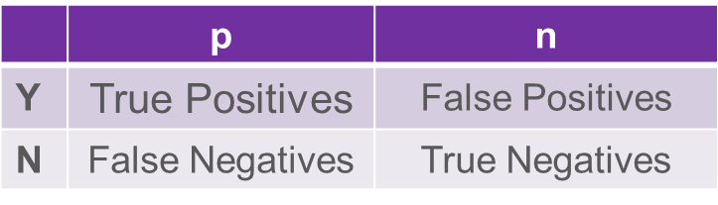
Evaluating Classifiers: The Confusion Matrix

Slide 45
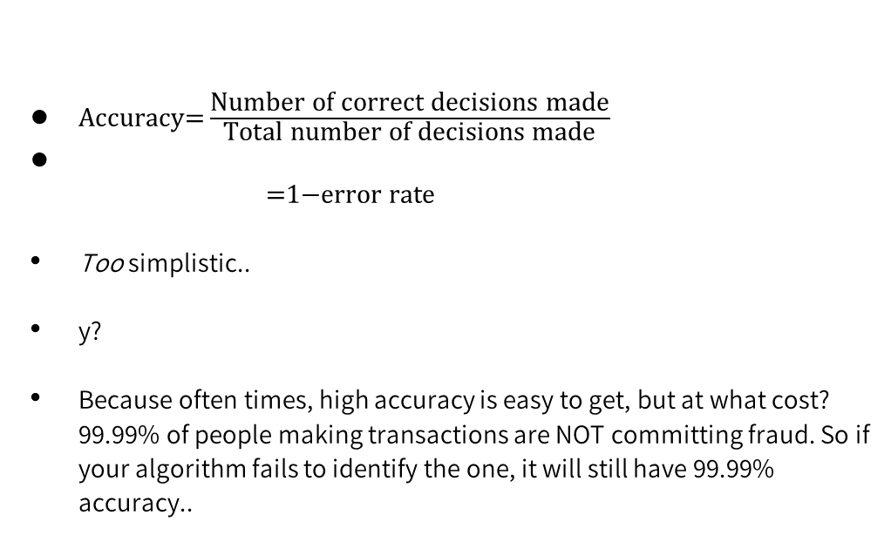
Evaluating Classifiers: Plain Accuracy

Slide 46
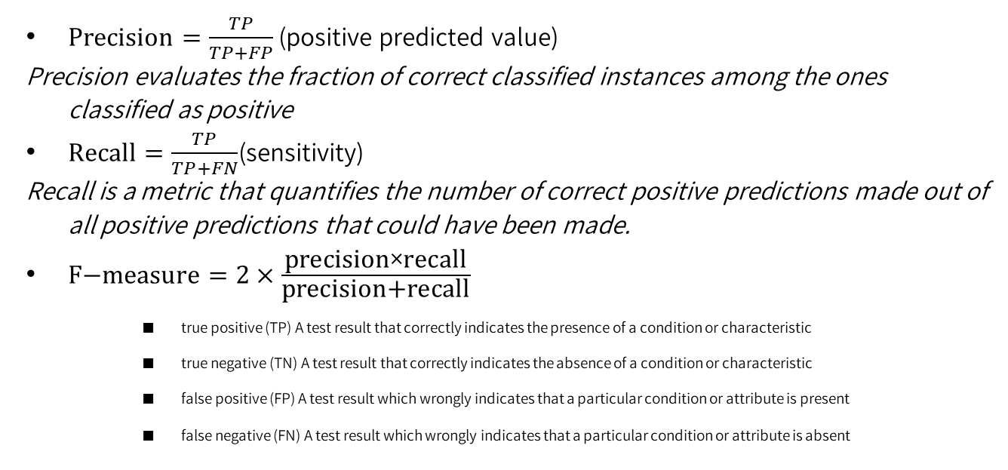
Other Evaluation Metrics
Notes:
F Measure also called F1 goes from 0 (poor) to 1 and combines precision and recall./
Generally, for imbalanced datasets, precision might be better because precision does not include the number of true negatives and thus it is not impacted by imbalance

Slide 47
For those who want to play with the python scripts
We won’t go through these slides, and they are roughly the same as the text in the jupyter notebook, just with a bit more visuals

Slide 48
We need to split our data before creating a model
Conventions
Put the data you want to predict (the label) in a DataFrame called y
Put the data that influence the label (the features) in a DataFrame called X

Slide 49
X = delays_df.loc[:,['DISTANCE', 'CRS_ELAPSED_TIME']]
y = delays_df.loc[:,['ARR_DELAY']]
index | DISTANCE | CRS_ELAPSED_TIME | ARR_DELAY
0 | 1670 | 225 | 7
1 | 580 | 105 | -4
2 | 425 | 96 | 5
… | … | … | …
299645 | 1500 | 210 | 73
Features
Label
DataFrame X
DataFrame y
index | DISTANCE | CRS_ELAPSED_TIME
0 | 1670 | 225
1 | 580 | 105
… | … | …
299645 | 1500 | 210
index | ARR_DELAY
0 | 7
1 | -4
… | …
299645 | 74

Slide 50
You need to split your data into training and test data sets before you train your model
index | DISTANCE | CRS_ELAPSED_TIME
0 | 1670 | 225
2 | 425 | 96
… | … | …
299645 | 1500 | 210
DataFrame X
X_train
index | DISTANCE | CRS_ELAPSED_TIME
0 | 1670 | 225
1 | 580 | 105
2 | 425 | 96
… | … | …
299645 | 1500 | 210
index | DISTANCE | CRS_ELAPSED_TIME
1 | 580 | 105
17 | 750 | 130
… | … | …
299643 | 425 | 100
train will be used to train the model
test will be used to test the model
Typically put aside 20 to 30% of your records for testing
X_test

Slide 51
scikit-learn
Open source library for preprocessing data and model training
train_test_split to split each of the X and y DataFrames into training and test DataFrames
from sklearn.model_selection import train_test_split

Slide 52
Now we can call train_test_split
X_train, X_test, y_train, y_test =
train_test_split(X, y, test_size=0.3, random_state=42)
X_train, X_test, y_train, y_test – names of DataFrames to create to store the training and test data
X – name of the DataFrame containing your features
y – name of the DataFrame containing your labels
test_size – what portion of the rows to put into the test data frames
random_state – sets the seed for random numbers - every time the code runs the same "random" sets of rows will be returned

Slide 53
What started in one DataFrame, is now split into four DataFrames
X_train
y_train
index | DISTANCE | CRS_ELAPSED_TIME
0 | 1670 | 225
1 | 580 | 105
… | … | …
299645 | 1500 | 210
index | ARR_DELAY
0 | 7
1 | -4
… | …
299645 | 74
index | DISTANCE | CRS_ELAPSED_TIME | ARR_DELAY
0 | 1670 | 225 | 7
1 | 580 | 105 | -4
2 | 425 | 96 | 5
… | … | … | …
299645 | 1500 | 210 | 73
X_test
y_test
index | DISTANCE | CRS_ELAPSED_TIME
2 | 425 | 96
17 | 750 | 130
… | … | …
299643 | 425 | 100
index | ARR_DELAY
2 | 5
17 | -1
… | …
299645 | 11

Slide 54
Once your data is prepared you can use it to train a model
X_train
y_train
index | DISTANCE | CRS_ELAPSED_TIME
0 | 1670 | 225
1 | 580 | 105
… | … | …
299645 | 1500 | 210
index | ARR_DELAY
0 | 7
1 | -4
… | …
299645 | 74
X_test
y_test
index | DISTANCE | CRS_ELAPSED_TIME
2 | 425 | 96
17 | 750 | 130
… | … | …
299643 | 425 | 100
index | ARR_DELAY
2 | 5
17 | -1
… | …
299645 | 11

Slide 55
There are different libraries and classes you can use to train a model
The scikit-learn library contains a number of different classes to train different types of models
The LinearRegression class fits a linear model
Call the fit method to fit your data to a linear model which can be used to predict the outcomes for new data

Slide 56
The code to train a model usually follows the same pattern
import the desired class from the library
from sklearn.linear_model import LinearRegression
Create an instance of the class
regressor = LinearRegression()
use the fit method to train the model using your training data
regressor.fit(X_train, y_train)

Slide 57
Once your model is trained you can test it using your test data
X_train
y_train
index | DISTANCE | CRS_ELAPSED_TIME
0 | 1670 | 225
1 | 580 | 105
… | … | …
299645 | 1500 | 210
index | ARR_DELAY
0 | 7
1 | -4
… | …
299645 | 74
X_test
y_test
index | DISTANCE | CRS_ELAPSED_TIME
2 | 425 | 96
17 | 750 | 130
… | … | …
299643 | 425 | 100
index | ARR_DELAY
2 | 5
17 | -1
… | …
299645 | 11

Slide 58
predict returns the values the trained model predicts for new data
Predict values for the test data in X_test
Compare the predicted values to the actual values in y_test to see how well your model performs
y_pred = regressor.predict(X_test)
y_test
y_pred
index | ARR_DELAY
291483 | -5.0
164800 | 20.0
… | …
60706 | -6.0
ARR_DELAY
3.48
5.80
…
6.08

Slide 59
It's impractical to visually compare predicted and actual values across thousands of rows
y_test y_pred
Instead we use standard calculations to get a sense of overall accuracy
index | ACTUAL_ARR_DELAY
291483 | -5.0
164800 | 20.0
… | …
60706 | -6.0
PREDICTED_ ARR_DELAY
3.48
5.80
…
6.08

Slide 60
Mean Squared Error (MSE) is the average error
MSE = mean((actual – predicted)**2)
You could write a python function to loop through each row, and perform this calculation
OR You could use mean_squared_error from the scikit-learn library
from sklearn import metrics
metrics.mean_squared_error(y_test, y_pred)

Slide 61
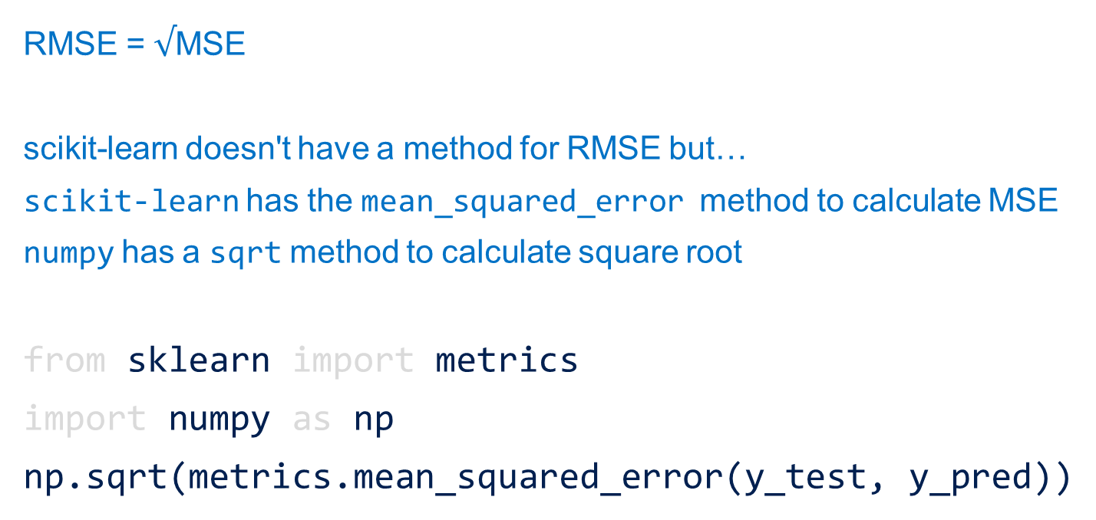
Root Mean Squared Error (RMSE) is the square root of the mean squared error

Slide 62
Different models have different metrics to measure accuracy numpy provides standard mathematical functions scikit-learn provides a number of functions for assessing prediction error Together they allow us to measure model accuracy

